Slide 1

Project 1:
Let’s Eat!
Team members:
Kasim ahmad, alex Blakemore, ann nguyen,
Lisa (islas) taylor, & Edwin vargas

Slide 2

Background:
Using survey data provided by college students of Mercyhurst University, we want to explore how food preferences are related to a student’s background. It would be interesting to explore if there’s a correlation between this sample size’s exercise habits, GPAs, and other factors in relation to what they prefer to eat. We plan to organize this survey data, explore it further with our questions, and preform calculations/visualizations to present this to our class.

Slide 3
Hypothesis:
How does a person's external environment and influences affect people's eating habits and perception of food?
Source: Kaggle

Slide 4

Questions????
How often do they cook/exercise?
  Any correlation between gender and exercise regimen?
  Does playing sports affect how often you exercise?
  Does living situation affect how often someone cooks?
How do parents education influence their eating habits?
  Any correlations between parent’s education and student’s eating habits?
  Any correlations between parent’s education and cooking at home?
  Compare student cooking, parent cooking, or student’s eating out?
  Correlation between student’s weight vs. eating out?

Slide 5
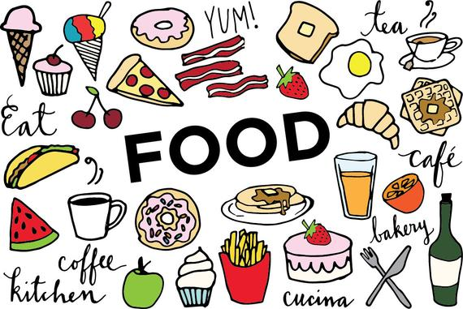
How did we get here????
Found data sets recommendations from Git Lab.
Looked at Kaggle & found lots of different data sets.
As a team we chose food, because everyone loves food.
  When we came across this data set, we felt there was enough information to start answering questions we had for this data.
  The information would help us approve or disprove our hypothesis
Source: Kaggle

Slide 6

How it started, how it ended…..

Slide 7
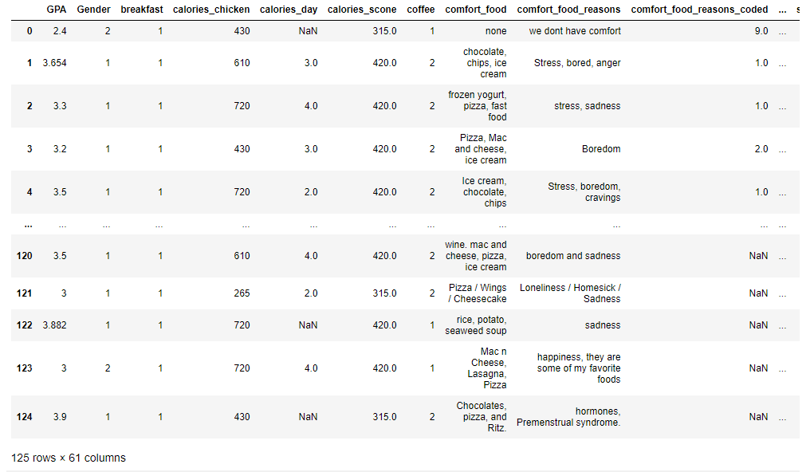
RAW DATA

Slide 8
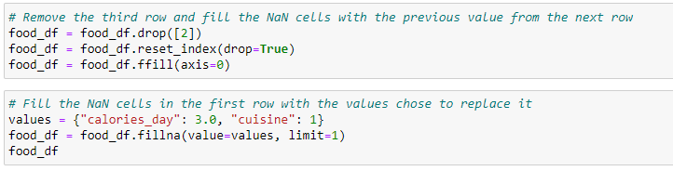


Slide 9
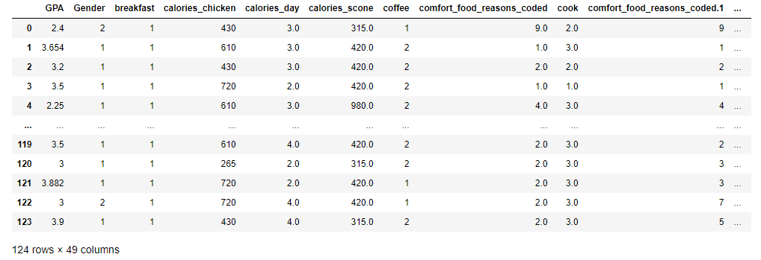
CLEAN DATA

Slide 10
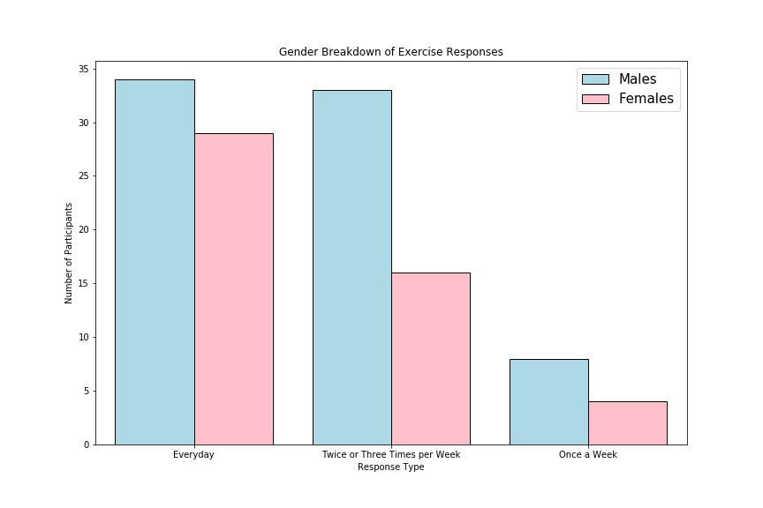
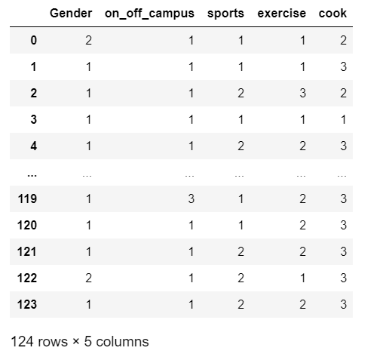
Any correlation between gender and exercise regimen?
Findings: Males: 34, 33, 8. Females: 29, 16, 4
Less female participates than males. Responses show that they’re even. There was no significant correlation to gender at the rate they exercise.

Slide 11
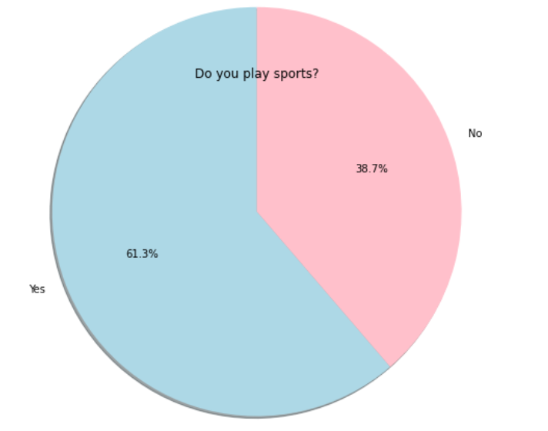
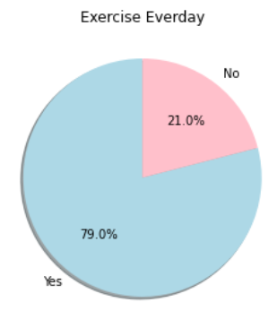

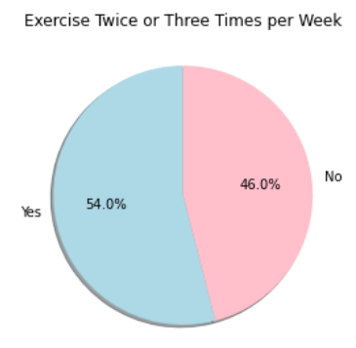
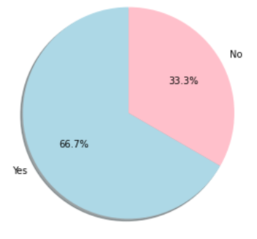
Does playing sports affect how often you exercise?
Findings: Did the participants play sports? The sub categories included if they exercised daily? Or how often they exercised? 1st pie chart 62 participants, 2nd pie chart 50 participants, 3rd pie chart 12 participants.

Slide 12
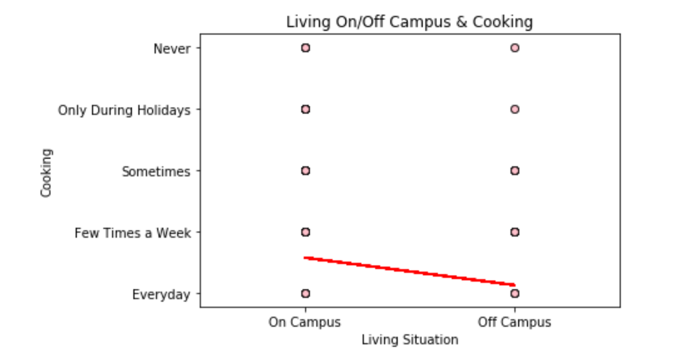

Does living situation affect how often someone cooks?
Findings: Linear regression at which rate students cooked. There is a small correlation, that if you lived off campus that you cooked more, vs living on campus

Slide 13
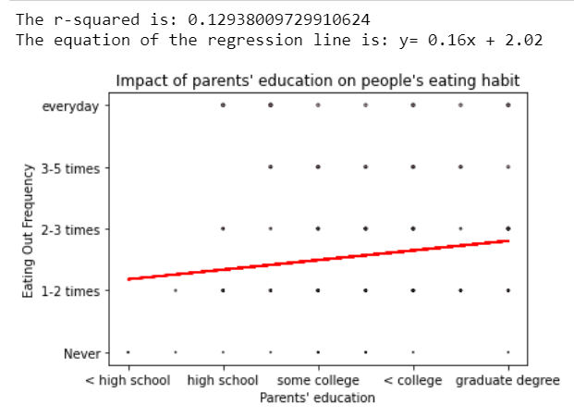
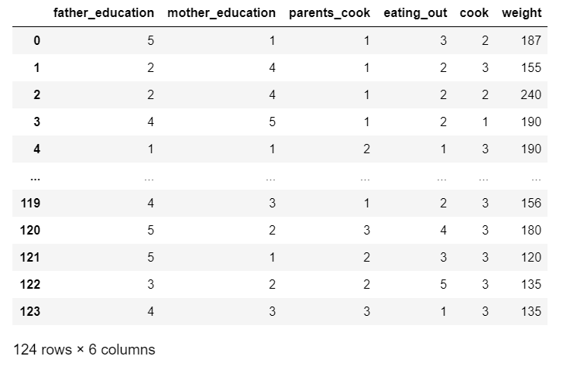
Any correlations between parent’s education and student’s eating habits?
Findings: There is minimum relevance between a person's eating out habit and parents' education level. However, we can see that the higher level the parents' education is, the more often will people eat out

Slide 14
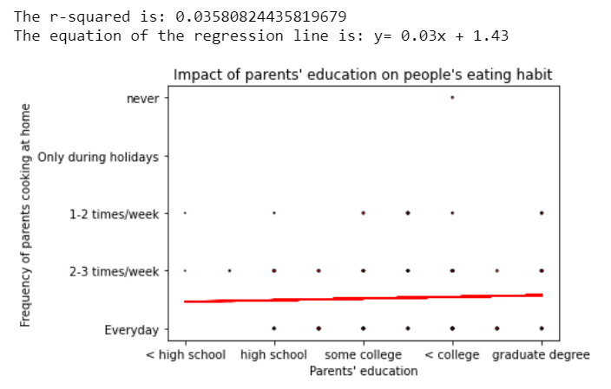
Any correlations between parent’s education and cooking at home?
Findings: Most parents cook at home almost everyday or at least 2-3 times a week regardless of the education level

Slide 15
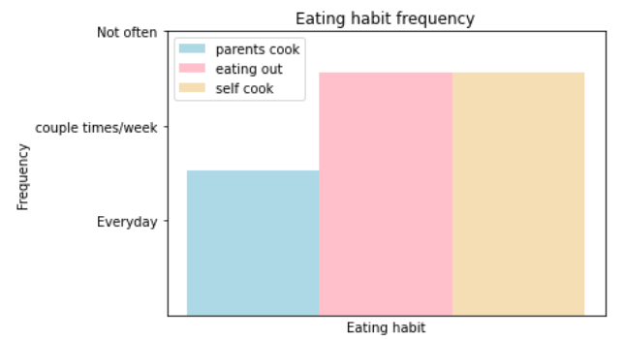
Compare student cooking, parent cooking, or student’s eating out?
Findings: People have the tendency of eating out or having their parents cook instead of self-cooking

Slide 16
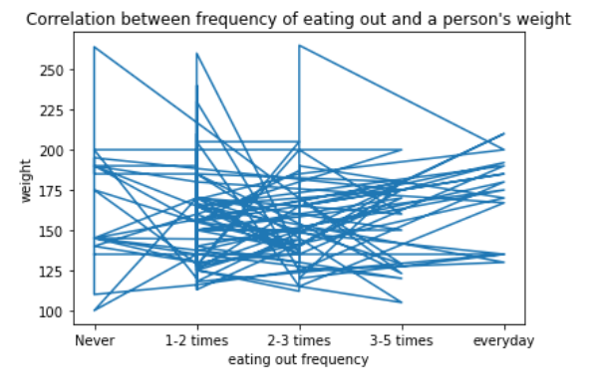
  Correlation between student’s weight vs. eating out?
Findings: There's no correlation between a student's weight and eating habit. We can conclude that people have a tendency of eating out with different frequency regardless of their weight.

Slide 17
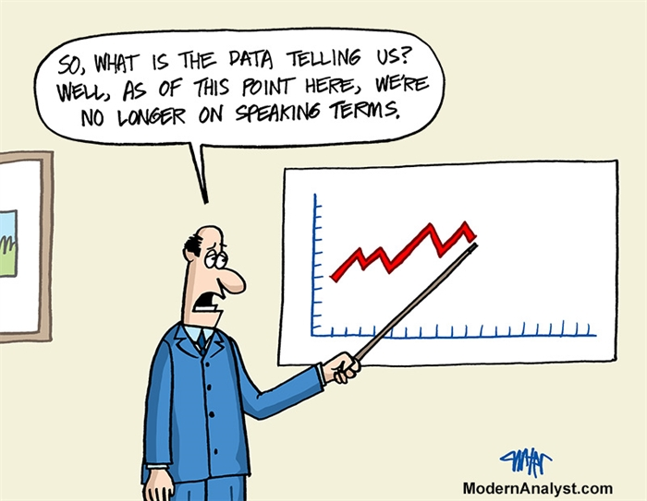

Slide 18
Data Analysis Conclusion:
Based on the conclusions found , our data suggests that there is no correlation between any of the relationships that we were examining.
  Any correlation found was insignificant (>0.01)
What we could do more more time and resources:
  Find another data set that is related where we can merge the data for more further exploration and grows our sample population
  Find a different way to deal with the NaN values that would allow us to further explore the data

